Slide 1
OVT/VTT alternations in Dutch: from corpora to experiment
Buren, A.M., Fuchs, M. & Le Bruyn, B.

Slide 2
Background

Slide 3
OVT/VTT alternations in Dutch
Notes:
Tense is a crucial aspect of language

Slide 4
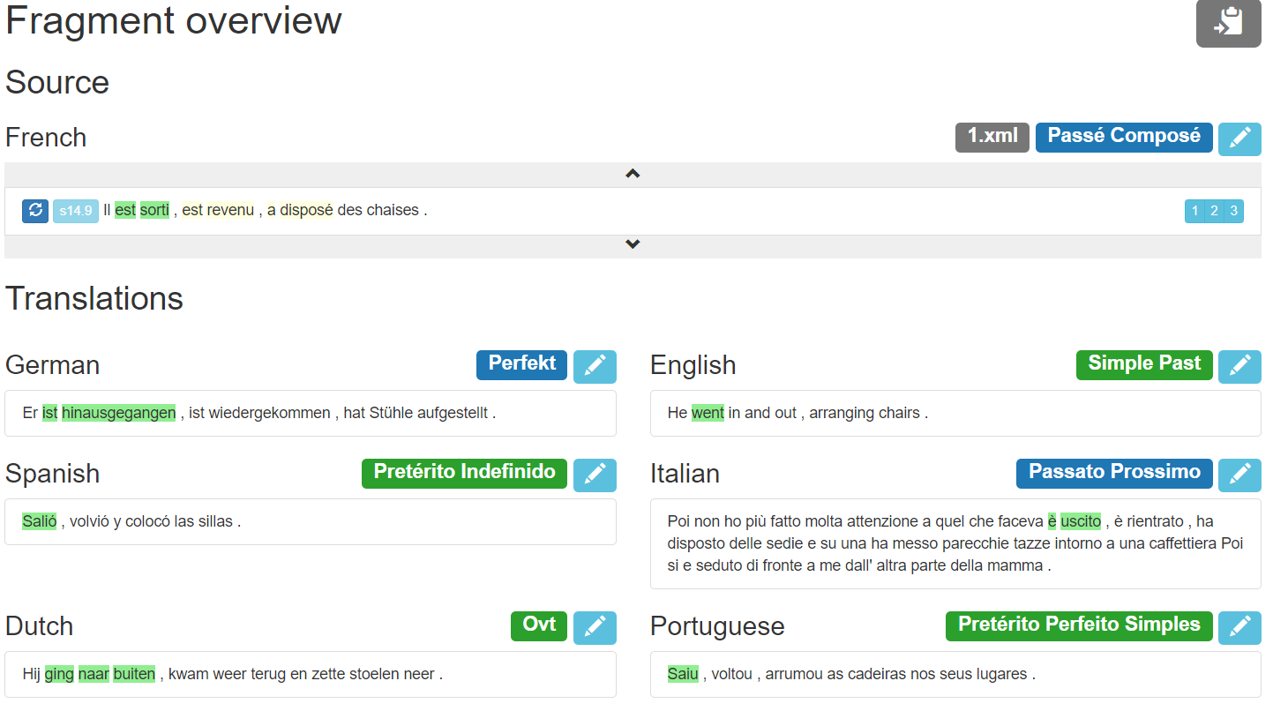
OVT/VTT alternations in Dutch

Slide 5
OVT/VTT alternations in Dutch
Notes:
Tense is a crucial aspect of language

Slide 6
Current Study

Slide 7
Aim, Research Question & Hypothesis
Goal: Experimentally confirming the VTT resists narrative use
Question: To what extent does the Dutch VTT resist narrative use?
Hypothesis: Following previous studies it is expected VTT resists narrative use
OVT/VTT alternations in Dutch

Slide 8
Methodology
Notes:
Production task
Picture based storytelling task

Slide 9
Participants Materials
N = 10
Students age 19-24
Native speakers of Dutch
Picture-based storytelling task
Cartoons of 6 frames
Brief instructions
OVT/VTT alternations in Dutch

Slide 10
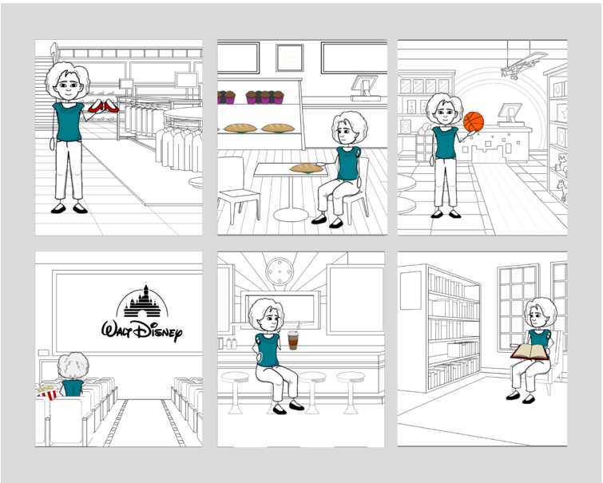
OVT/VTT Alternations in Dutch Sample Stimulus

Slide 11
Procedure
Participants got randomly placed in one of two conditions (narrative vs. non-narrative).
Brief instructions based on condition:
Online, through voice-recording
NARRATIVE: Vertel het verhaal van Maria’s trip van gisteren naar het winkelcentrum. Begin met: “Er was eens…”
NON-NARRATIVE: Som de activiteiten van Maria’s trip van gisteren naar het winkelcentrum op.
OVT/VTT alternations in Dutch

Slide 12
Predictions
Participants will produce OVT in narrative condition.
VTT will be preferred in non-narrative context (for event verbs).
OVT/VTT alternations in Dutch

Slide 13
Analysis
All verbs were coded for tense marker
Two independent annotators coded all verbs for lexical/predicational aspect
State/event/(unbounded) activity
Relative frequencies comparison to account for length differences between the conditions/participants
OVT/VTT alternations in Dutch

Slide 14
Results

Slide 15
Notes:
OVTT: Ze zou lopen (she would walk) – future in the past/conditional
VVT: Ze had gelopen (she had walked) – past perfect
OTT: Ze loopt (she walks) - present

Slide 19
Discussion

Slide 20
On VTT/OVT use in narrative/non-narrative contexts
Dutch VTT resists narrative use: events (accomplishments, achievements and bounded activities) that are integrated into a sequence that follow each other in time ban its use, and the OVT must be used.
Within non-narrative contexts, on the other hand, only the Dutch VTT is used (for events and activities).
OVT/VTT alternations in Dutch

Slide 21
Conclusion

Slide 22
Conclusions
The narration/non-narration contrast is at play in the distribution of OVT/VTT use in Dutch.
Discourse register constraints are part and parcel of the semantics (and use conditions) of Perfect markers.
Experimental tasks can provide converging evidence to generalizations obtained from parallel corpora-methods.
OVT/VTT alternations in Dutch

Slide 23
Moving forward…
Try slightly different experimental prompts:
Not give starting sentence >> but might be too open-ended.
Start with: “Tijdens…” (non-narrative) vs. “Op een dag…” (narrative) to avoid any tense marker.
OVT/VTT alternations in Dutch

