Slide 1
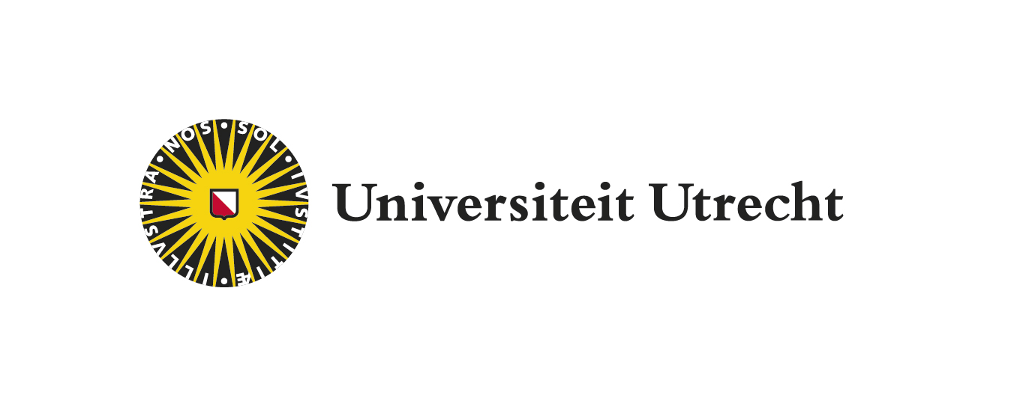
Combining corpora and experimental methods in crosslinguistic semantics
Martín Fuchs
Utrecht University
Functional and Cognitive Linguistics Research Group Department of Linguistics. KU Leuven
24 March 2022
Notes:
Hi, I’m Martín Fuchs, from Utrecht University, thanks for having invited me to present my research here at KU Leuven, where today I’ll be talking about how to combine parallel-corpora and experimental methodologies to address problems in semantics from a crosslinguistically perspective. As you can see, I’ve changed the title a little, since the focus will be more on the combination of methods, and less so on the Present Perfect puzzle, which I’ll talk about only in the end.

Slide 2
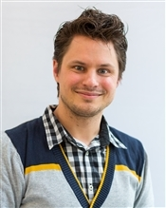
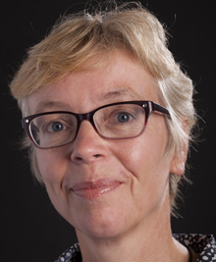
Collaborative work (Time in Translation)
Martijn van der Klis
Henriëtte de Swart (PI)
Bert Le Bruyn (PI)
Notes:
And this research is collaborative work with several members of the Utrecht University based, Time in translation team, PhD student Martijn van der Klis, and the two PIs, Henriette de Swart and Bert Le Bruyn

Slide 3
Time in Translation NWO-project (2017-2022)
Write a crosslinguistically valid semantics of the PERFECT marker : HAVE + Past Participle.
Based (originally) on five Western European languages (Dutch, German, French, Spanish, English).
Ingredients at the lexical, sentential, discourse and extralinguistic level.
Main methodology: Translation Mining (parallel-corpora)
Corpora: Camus (1942) L’Etranger, and J.K. Rowling (2012) Harry Potter and the Philosopher’s stone.
Notes:
Time in Translation is a NWO-funded research project with the general goal of writing a cross-linguistically valid semantics of the HAVE-Perfect (that is the combination of an auxiliary have and a past participle) on the basis of comparing (originally, although this has been expanded in many ways) five Western European languages: Dutch, of course, German, French, Spanish and English. And to identify different ingredients for this semantics, at the lexical, sentential, discourse and extralinguistic level, we have been making use of a new methodology that we have called Translation Mining, which is a specific approach to parallel-corpora research. I arrived to this project in 2020, but my colleagues have been working on this since 2017, firstly making use of a parallel-corpus made out of L’etranger, Camus’ novel, and its translations into these languages, which will be our focus today, and a second stage, where we have been using the first volume of the Harry Potter’s series.

Slide 4
Roadmap
1. Introduction & Research Questions: The semantics of the Perfect, its competition with the Past, and its crosslinguistic variation.
2. Methods: Translation Mining and L’étranger: subset relation across languages.
3. Testing for the reliability and granularity of parallel-corpora methods.
4. A case study: the Present Perfect puzzle in English and Spanish (and Dutch) through an acceptability judgment task.
5. General conclusion (tl;dr): triangulate your data for better generalizations and wider empirical coverage.
Notes:
So in today’s talk, I’ll first introduce you to our main research questions about the semantics of the Perfect, its competition with the Past markers, and its crosslinguistic variation. I’ll then present the Translation Mining method in relation to L’etranger and the subset relation in Perfect Use that my collaborators have found across languages. Then I’ll present some ideas on how to test for the reliability and the granularity of the generalizations that can be extracted from parallel corpora methods, specifically by introducing a case study of an experimental acceptability judgment task in English, Spanish and Dutch about the Present Perfect Puzzle. And in the last part of the talk, we will reflect on the advantages of combining these two methodologies.

Slide 5
introduction
Notes:
So let’s begin.

Slide 6
Introduction Perfect/Past in English
Variation between Perfect and (Perfective) Past forms responds to a set of constraints not clearly understood. (1) and (2) are both possible:
Mary ate breakfast at that café. (Perfective) Past E-R < S
Mary has eaten breakfast at that café. (Present) Perfect E < R,S
but constraints in (3) and (4) only allow the Simple Past and bans Perfect use:
Mary (#has) left work at 5pm. R=S restricts past-time adverbs
When Mary (#has) left, she (#has) waved at me. R=S blocks anaphors/narration.
Notes:
Variation between Perfect and Perfective Past forms responds to a set of constraints not clearly understood. If we look at (1) and (2), we see in (1) the Past marker in English, the Simple Past,, and in (2) the Perfect marker, the Present Perfect. So what is the difference in this case? When I say that Mary ate breakfast at that café, as in (1), I might imply that she did so yesterday, or last Tuesday, but it seems that the time of the event is relevant, and from a Reichenbachian perspective, the reference time is at the event time, in the past, before speech time. On the contrary, when I say Mary has eaten breakfast at that café, it feels that what I’m focusing on is the experience of having had breakfast there, or the result (that is, she is fed now), but the time of the event is before both reference and speech time.
That is why in a sentence like (3) we cannot add a modifying adverb that refers to the past and use the Perfect marker, since the adverb modifies the reference time, which overlaps with speech time. This fact also prevents narration with the present perfect, as shown in (4), where we also need to use the Simple Past in English.

Slide 7
Introduction The Perfect
The PERFECT: auxiliary (have) + past participle (i.e., have perfect, Dahl & Velupillai 2013).
Core meaning: past event and resulting state with current relevance.
The Perfect is said to display at least four different readings (e.g., Iatridou et al. 2003, Portner 2003, i.a.):
Resultative: Mary has moved to Utrecht (now she lives there).
Experiential: Mary has visited Utrecht (and she knows it, she might go again).
Continuative: Mary has lived in Utrecht for 5 years (and she still does)
‘Hot news’ (hodiernal): Mary has won the lottery (just now)!
Notes:
Then, when do we use the (HAVE) Perfect, the form that contains the auxiliary have and the past participle? The main idea is that the core meaning of this construction includes a past event and a resulting state with current relevance. That is why many scholars have proposed that the Perfect has four different readings. The resultative reading, as in Mary has moved to Utrecht, where the focus is on the result state (she lives there now); the experiential reading, as in Mary has visited Utrecht, (and she might go again), where the focus is on the fact that this event occurred at some point in time, and is part of an experience of Mary; the continuative reading, with stative predicates, as in Mary has lived in Utrecht for 5 years (which implies that she still does), so that the state continues into the present, and the so-called ’hot news’ reading, as in Mary has won the lottery (which implies that this event has just happened). Arriving at a unified semantics that can account for all these readings has been the focus of most research related to the Perfect so far.

Slide 8
Introduction Lack of crosslinguistic coverage
However, most research has been done in English (e.g., McCawley 1981, Michaelis 1994, Portner 2003, Nishyama & Koenig (2010), where these descriptions (and partially those analyses) work.
However, different languages allow their corresponding Perfect (and Past) marker to express these readings to different extents.
Marie a pris / (#prit) le petit-déjeuner dans ce café
Maria heeft (in dat café) ontbeten / (ontbeet) in dat café
Maria hat gefrühstückt / (frühstückte) in diesem Café
María (ha desayunado) / desayunó en ese café
There are some language-specific analysis other than English (Bertinetto 1986, Vet 1992, Boogaart 1999, Löbner 2002, Howe 2006) and also, more recently, some awareness of cross-linguistic variation (e.g., de Swart 2007, Schaden 2009, Dahl & Velupillai 2013).
Notes:
Now, one problem with this approach has been that most of this research has focused in English and English only. While these descriptions work for English, one can readily notice that when translating those sentences to other languages, not all these readings are available for equivalent, Perfect markers, and moreover, there are languages that use their Perfects way more broadly.
For instance, French prefers the Passe Compossé, the Perfect, to express that Mary had breakfast at that café, while Dutch and German also use their Perfect markers extensively. Spanish also seems to be able to use both, but more restrictedly, like English, with some nuances in the meaning with each marker. There are some analysis of these markers that are language-specific for languages different from English, and more recently, there has been some interest in cross-linguistic analysis of the perfect.

Slide 9
Introduction Constraints in other languages
French, Dutch, German perfect: compatible with past time adverbials.
Marie est sortie du travail à 17 heures. [French]
Maria is om 17 uur van werk weggegaan. [Dutch]
French, German perfect: allow narrative use, but Dutch does not.
Quand Marie est partie, elle m’a fait signe. [French]
#Toen Marie is weggegaan, heeft zij naar me zwaaiden. [Dutch]
Three-way division of languages (de Swart 2007):
German/French can use perfect in narration, or w/past-time adverbs;
Dutch is ok with past-time adverbials, but not with narration
English (and Spanish?) cannot do either.
Notes:
For instance, if we look at the two constraints about Perfect use in English that we mentioned –the impossibility to combine with past-referring adverbials, and the impossibility to be part of narration– first we see that French, Dutch and German are actually compatible with this kind of adverbs.
When it comes to narration, it looks like French and German can use their Perfect markers, but Dutch cannot, and needs to resort to the ovt, its past marker. That’s what led de Swart to propose a three-way division of languages with respect to Perfect Use: German and French can do everything, Dutch can’t do narration, and English (and maybe Spanish, although she does not refer to it) can’t do either.

Slide 10
Introduction Diachronic and synchronic variation
Perfect is diachronically unstable (“aoristic drift”) (Harris 1982, Dahl 1985, Bybee et al. 1994).
Condoravdi & Deo (2014): Resultative aspect markers often develop into perfect markers, which then end up as perfect plus perfective markers.
Schaden (2009): to understand the Perfect, we need to look at is competition with the past. A dichotomy where Spanish/English pattern together, as opposed to German/French.
Variation across dialects is also prevalent (e.g., for Spanish, Howe 2006, Fuchs & González 2022).
(Not) Surprisingly: crosslinguistic variation has had little effect on semantic accounts of the perfect (focused on English).
Notes:
We also know that the Perfect displays a lot of diachronic and synchronic variation. Perfect markers are involved is what is known as the aoristic drift, a grammaticalization path that has been modeled, for instance, by Condoravdi & Deo in Indo Aryan languages, by proposing that resultative markers first develop into perfect markers, and later encroach into the domain of more perfective-like readings.
Schaden has proposed that looking at this competition with the PAST markers is crucial to understand the perfect, and has shown a dichotomy where Spanish and English pattern together in their very restrictive use of the Perfect (and a broad use of the Past), while German and French make a broader use of their Perfect marker, and a limited use of their Past Marker.
There is additionally the problem of dialectal variation, which has partially been addressed for Spanish, which shows slightly different use patterns in Spain than in different regions of Latin America.
But, crucially, all this variation has had little effect on the proposals on the meaning of the Perfect.

Slide 11
Introduction Our methods
Research question:
Which features differentiate the past and the perfect in languages that have two markers? Are there only constraints on past-time adverbials and narration? Is there something more at play?
How to tackle the problem:
Parallel corpus : translation (same context/meaning, different forms).
Data-driven: extract all finite verb forms in one language, align with translations, analyze similarities/differences in marker use in context.
Look at data patterns and extract generalizations.
Experimentally check the reliability (and the granularity) of the results.
Notes:
So, we propose here to study which features differentiate the PAST and the PERFECT in languages that display these two markers, and we will focus on trying to understand, besides the role of past-time adverbials and narration, whether there is something more at play.
To tackle this problem, the Time in Translation project has been using a parallel-corpus approach, where we compare an original text to its translations. The rationale behind this method is that by keeping the context (that is, the meaning) constant, we can look at the forms that translators chose in each translation and see whether there are grammatical constraints that make them change or keep the cognate form in the original. This is very much a data-driven method, where we extract verbal forms, look at quantitative differences and similarities across languages, but also dive deep into the data and extract generalizations from the patterns. Lastly, we check the reliability of those results by experimental tasks, which can also help us in refining our generalizations.

Slide 12
Translation mining
Notes:
So, what is Translation Mining? What makes this parallel corpus approach special?

Slide 13
In a nuthsell…
Convert texts + translations into electronic documents.
Extract all finite forms from multilingual corpora (e.g., Passé Composé)
Align sentences (based on VPs) between original and translations.
Mark TMA forms in the translations (with their language-specific labels: Present Perfect, Simple Past, Pretérito Indefinido, Ontvolooid Verleden Tijd…)
Create a dissimilarity matrix to compare forms
Use multidimensional scaling to visualize variation in a semantic map
Go back to the actual data and extract generalizations.
Algorithms created by the Digital Humanities Lab of Utrecht University
Notes:
In a nutshell, the methods works as follows. First, we convert all texts and the translations into electronic documents. Then we extract all finite forms from the different corpora. We then align these sentences (based on the VPs) between the original text and its translations. We manually annotate the markers in the translations with their specific names in each language; we create a dissimilarity matrix to quantitatively compare the forms and how they change from one language to another, we use a visualization technique that allows us to plot variation in a semantic map, and then we go back to the data to extract our linguistic generalizations. So let me walk you through each of these processes…

Slide 14
1. VPs Extraction
Application that is able to extract all finite forms across languages. For instance, for the Perfect:
Looks for an auxiliary verb (Have/Be)
Finds a neighboring past participle
Takes care of words in between, lexical restrictions, reversed order, passive present perfects.
Notes:
After converting the texts into electronic documents, we use an application that looks for all finite forms. For instance, in the case of the Perfect, it looks for the combination of an auxiliary and a neighboring past participle in the original text automatically. This application manages to take care of the words that are in between the auxiliary and the participle, of lexical restrictions, reversed order, etc.

Slide 15
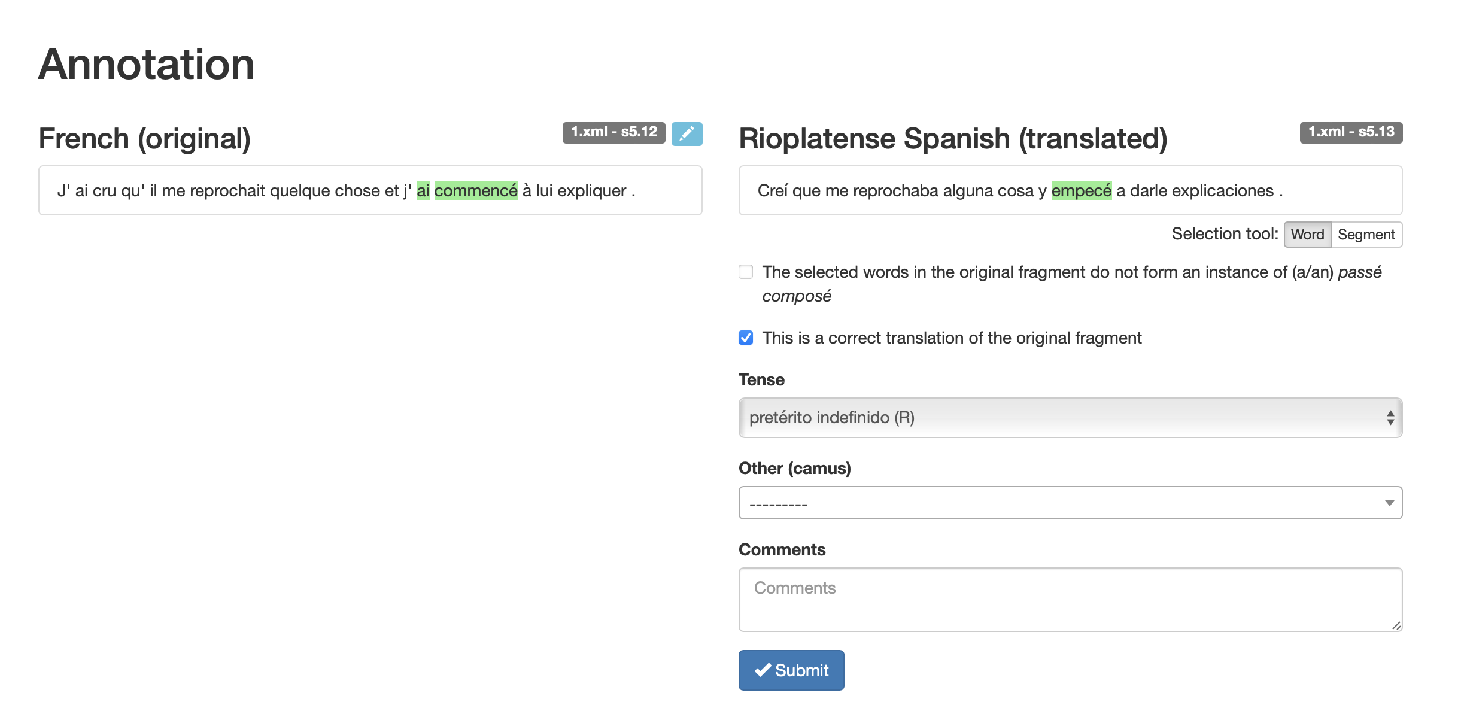
2. Verb/Sentence alignment
TimeAlign Application
Allows for manual alignment of translations.
Notes:
The second step is done through the Time Align application, which aligns the original, here in French, with its translations, here in Rioplatense Spanish. The annotator can decide whether it is a correct translation of the fragment, and whether there is or not a passé compossé in the source, allowing to check the automatic extraction of step 1.

Slide 16
3. Marker assignment
To calculate “distances” between fragments, we assign a TMA marker to every selected translation.
Notes:
If the annotator decides that the extraction was done correctly in the source fragment and there is a translation available, the annotator can select the words that make up the translation, in this case “empecé”, and then select for the tense in that specific language; in this case, pretérito indefinido. One can also add comments for further data exploration.

Slide 17
4. Dissimilarity matrix
Distance function: a pair of source and translations is maximally similar (d=0) if all tenses match up across languages. We compute +1 for every ‘mismatch’.
# | German | English | French | Spanish | Dutch
1 | Perfekt | Present perfect | Passé composé | Pretérito perfecto compuesto | Voltooid tegenwoordige tijd
2 | Präterium | Simple past | Passé composé | Pretérito perfecto compuesto | Voltooid tegenwoordige tijd
3 | Perfekt | Present perfect | Passé simple | Pretérito Indefinido | Voltooid tegenwoordige tijd
d(1, 2) = 2/5 // d(1, 3) = 2/5 // d(2, 3) = 4/5
Notes:
Once we have annotated all forms, for instance the Perfect here, and their translations, we can create a dissimilarity matrix. Think of each row here as a specific case or context. In the first context, we have a Perfekt in German, a Present Perfect in English, a passé compossé in French, a pretérito perfecto compuesto in Spanish, and a vtt in Dutch. In the second case, we have a Prateritum in German, a Simple Past in English, a Passé Composé in French, a perfecto compuesto in Spanish and a vtt Dutch. So if we want to compare the distance between these two contexts in a multilingual way, we need to see how many of these markers match across these contexts (if they all match, the distance is zero, and our assumption is that those contexts are maximally similar between them with respect to the potential dimensions of variation). So here, if we compare the context in (1) and the one in (2), we see that they match in French, Spanish and Dutch, but they mismatch in German and English, so their distance is 2/5. If we do that between (1) and (3), we observe that they are the same in German, English, and Dutch), but they are different in French and Spanish, also with a distance of 2/5.

Slide 18
4. Dissimilarity matrix
On the basis of the distance functions for each pair, we can create a dissimilarity matrix.
 | #1 | #2 | #3
#1 | - | 2/5 | 2/5
#2 | 2/5 | - | 4/5
#3 | 2/5 | 4/5 | -
Notes:
When we calculate all distances we can generate a dissimilarity matrix, in which each cell is a pairwise comparison between two contexts, two cases in our data, across all languages that we are interested in.

Slide 19
5. Multidimensional Scaling
Multidimensional Scaling (MDS; Wälchli & Cysouw 2012) takes the dissimilarity matrix as input and creates a low-dimensional representation of the data, respecting the distances in the high-dimensional space.
It generates a cartographic visualization of groups of tense uses in context.
It creates a two-dimensional map (a scatter plot), based on the comparison of all contexts in all the languages.
Each dot represents a context (with the specific configuration/tuple across languages). Clusters are dots that are equal in their configuration.
We use the tenses per language as labels with color coding.
We can filter the tenses to see specific ones.
We can switch between languages.
We can click on individual points to see the source and translations.
Notes:
This is the input to our visualization technique, which is Multidimensional Scaling. This technique takes this input and creates a low-dimensional representation of the data, in a cartographic way that represents different groups of tense uses in context. The scatter plot that it creates is based on comparing all contexts in all languages, where each dot represents a given context (with its specific configuration). Clusters of dots represent contexts that are equal in their configuration (that is, they select the same markers in each of the languages –not the same in all languages, but the same in each language –that is, if context A had English Past and Perfect in all the others, and context B had the same configuration, they cluster together). We then use the specific language labels and color code them, so that we can filter specific tenses to focus on some comparison, and we can also switch between languages, and see changes in the distributions. We can also click on individual points to see the original fragments and the translations.

Slide 20
Corpus: L’étranger and its translations (van der Klis et al. 2020 et seq.)
Classical narration in French literature: Passé Simple + Imparfait (= perfective/imperfective past ≈ sequence of events/states).
L’Etranger: sequence of Passé Composé + Imparfait (= perfect + imperfective past). This was not regular narrative style (in 1942).
Obviously this style raises translation problems in languages that have a less liberal/more restricted use of the perfect.
Approach: temporal maps showing the competition between perfective past and perfect.
From language use to grammar: determine the criteria that perfect use is sensitive to in French, German, Dutch, Spanish and English.
Notes:
Let me show you how it works, with the first study that the Time in Translation team did, which already resulted in a series of publications.
The first corpus that the team used was L’etranger, a novel by Albert Camus published in 1942. Typical narration in French is or was done with the Passé Simple, and the Imparfait, reflecting a difference between perfective and imperfective past. L’etranger was very “modern” in that instead of using the Passé Simple, it used the Passé Composé to narrate the events. This obviously raised some translation problems, since other languages have a more restricted (as in “grammatically banned”) use of their perfect forms, but since this was a stylistic choice in the original, we argue that translators would intend to maximize perfect use in their languages, unless really disallowed. They first then did all the processes that I described before (extract Perfects, annotate, etc.), and produce maps showing the competition between the Perfect and the Past, and later went to look at the real data to determine the criteria that are relevant for perfect use across these languages.

Slide 21
French
Notes:
So, this is what the output of multidimensional scaling looks like. In this case, we are looking at all infinitive finite tense marking in the Camus novel. We see in blue the passé composes, in dark green the passé simples, in mustard green the imparfait, and so on…

Slide 22
German
Notes:
As I said before, we can change the language of the maps, in the interface that is displayed in the bottom of the screen. If we change it to German, we see the same map, with some colors that have changed, but crucially the dots are labeled with the language-specific forms. Blue for the Perfekt, green for the Prateritum, Orange for the Präsens, and so forth. We see for instance,that there is no imparfait, and that all imparfaits (which were in mustard) in French, change for green Präteritums in German, which does not have separate markers instantating this distinction.

Slide 23
Dutch
Notes:
We can do the same for Dutch…

Slide 24
Spanish
Notes:
For Spanish…

Slide 25
English
Notes:
And for English… But these maps with all markers can become a bit confusing. That is why our interface also let us unclick, or select some specific markers, the ones that we are interested in.

Slide 26
French - Perfect and Past
Notes:
So if we want to look at the variation between Perfect and Past markers, we can select just those –the passé composé and the passé simple, and the imparfait– in the French original, and see a more clear picture of how this domain is mostly instantiated by the passé compossé form in French.

Slide 27
French - Perfect and Past
Notes:
To make the comparison even more clear to the eye, we can add convex hulls that surround the clusters that belong to the same marker in a specific language. So, let’s not pay much attention to the imparfait, but to the actual competition between the perfective past (in languages that have two simple forms) and the Perfect. Here, in the blue cluster, we have all the passé compossés.

Slide 28
German - Perfect and Past
Notes:
When we now look at German, besides the increase in the green area, (mostly by virtue of the imparfaits that became green, even if we’re not considering them right now), what is crucial is that the blue area shrunk. (move back). In particular, there are those 22 points in the middle, that 22-point cluster, that became green; that is, that it was a passé composé in French and is now a Präteritum in German.

Slide 29
Dutch - Perfect and Past
Notes:
If we look at Dutch, we see a further reduction, which now crucially affects those 316 points in the middle, that have become an ovt, the dutch past, instead of the original passé composé, or the german Perfekt.

Slide 30
Spanish - Perfect and Past
Notes:
Now moving into Spanish, we see a clear extension of the green area, of the past marker, and a further reduction of the blue, principally losing that 27-context cluster in the middle right, that was a vtt, a perfect marker in dutch, and is now a pretérito Indefinido, a past marker.

Slide 31
English - Perfect and Past
Notes:
The English map looks a bit more messy, but the crucial thing to observe here is that there were 6 contexts (in the right) that were pretéritos compuestos in Spanish, the perfect form, and have become now a Simple Past.

Slide 32
Descriptive statistics
Notes:
we can also look at the different tuples or different combinations that exist across languages, which are, in turn, the clusters on the map, as I described before.

Slide 33
Descriptive statistics
4. not Dutch
3. not Spanish
5. not German
1. All
2. not English
Notes:
And when we do this, we see (with respect to Perfect/ Past variation) five crucial rows. In the row marked with 1, we see that there ae 10 contexts where all languages are blue, they all use a Perfect. Now, in the row marked with a 2, we see that there are 6 contexts where all languages manage to maintain the original Perfect in French, but only English needs to change to the Past. In the row marked with a 3, that happens to Spanish. There are 27 contexts in which Spanish (and crucially English too) need to resort to their Past forms, while German and Dutch maintain their Perfect. The big change in numbers comes in 4, where only German and French share a Perfect, but all the other languages, now including Dutch, need a Past, with 316 cases. Finally, we have the 22 contexts where not even German keeps a Perfect form, and switches the French passé composé for a Präteritum.

Slide 34
Descriptive statistics
The Passé Composé is generally translated by a perfect in German, and by a past in Dutch/Spanish/English.
The most frequent combination: < Passé Composé, Perfekt, Simple Past, Pretérito Indefinido, ovt>.
German patterns with French, Spanish pattern with English: variation within the family of Romance/Germanic languages (Schaden 2009)
Notes:
These descriptive statistics allows us to see general patterns; for instance, that the passé composé is mostly translated by a Perfect in German, and by a past in the other languages, because the most frequent combination is one with passé composé, perkeft, simple past, pretérito Indefinido, and ovt in dutch. In this way, German seems to pattern with French; and Spanish with English. Both in the Germanic family and in the Romance family, there is a liberal Perfect language (French in Romance, German in Germanic) and a restricted one (Spanish in Romance, English in Germanic).

Slide 35
From statistics to grammar
Limits of descriptive statistics: global tendencies at the level of the grammar.
Principle of isomorphism (Haiman 1985): variation in form reflects variation in meaning.
Multidimensional Scaling (Wälchli & Cysouw 2012): generate a cartographic visualization of groups of tense uses in context.
Notes:
But these descriptive statistics only show us these global tendencies. However, we consider that variation in form really reflects variation in meaning, and our cartographic visualization techniques allows us to dig deeper.

Slide 36
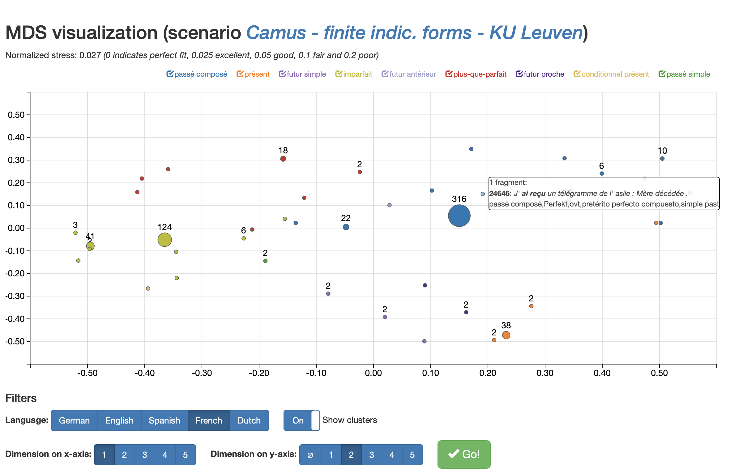
From the maps to the data
Notes:
When we have a full map, in this case in German, we can go to a specific context, or cluster, and click on it.

Slide 37
Dynamic Interface: back-and-forth between maps and data
Notes:
When it is just one case, it will bring us to this page, where we see the original and its translations (when the cluster is larger, we get to an intermediate page where all cases with that configuration are listed, and we can look at them one by one).
So in this case, we see the French passé composé, the German Perfekt, the Spanish pretérito perfecto compuesto, the Dutch OVT, and the English SImple Past. This is one case that looks like an exception to our main clusters, (because spanish has a perfect and dutch a past), and that’s why there is probably only one case.

Slide 38
French - Perfect and Past
Notes:
But the idea holds. When we compare French with German

Slide 39
German - Perfect and Past
Notes:
We clearly see that the main change are those 22 points that go from Perfect to Past in the middle. If we look at those cases in detail, what do we see?

Slide 40
French > German: state verbs (in a narrative sequence)
Lexical semantics drive the distinction between French and German.
All languages but French require a past tense form with states in a narration.
a. | J’ ai voulu voir maman tout de suite. | [French]
b. | Ich wollte sofort zu Mama. | [German]
c. | Ik wilde moeder meteen zien. | [Dutch]
d. | Yo quería ver a mamá inmediatamente. | [Spanish]
e. | I wanted to see mother straight away. | [English]
Notes:
The crucial distinction between French and German (once we look at the 22 cases) seems to be driven by lexical semantics. French is the only language that allows a state to be expressed with a Perfect form inside a narrative sequence, while all other languages require a Past form, even German. (read the example). So a lexical semantic element will need to be part of the semantics of the Perfect.

Slide 41
German - Perfect and Past
Notes:
If we look at the difference between German and Dutch now

Slide 42
Dutch - Perfect and Past
Notes:
The crucial set of points that change color are those 316 in the middle right.

Slide 43
German > Dutch: narration
The German Perfekt can be used to tell a story (Löbner 2001, Schaden 2009).
The Dutch VTT resists temporal progress in discourse (dynamic semantics).
a. | Il est sorti, est revenue, a disposé des chaises. | [French]
b. | Er ist hinaus gegangen, ist wieder gekommen, hat Stühle aufgestellt.. | [German]
c. | Hij ging naar buiten, kwam weer terug en zette stoelen naar. | [Dutch]
d. | Salió, volvió y colocó las sillas. | [Spanish]
e. | He went in and out, arranging chairs. | [English]
Notes:
When looking at those cases, what we observe is that while German can use its Perfect form for narration, the Dutch counterpart, the VTT, resists temporal progress in discourse, and resorts to the past marker, the OVT. (read the example). So discourse, dynamic semantics, are also part of the Perfect.

Slide 44
Dutch - Perfect and Past
Notes:
Moving from Dutch to Spanish

Slide 45
Spanish - Perfect and Past
Notes:
The crucial points under analysis are those 27 cases that have now turned green, marked with the pretérito Indefinido.

Slide 46
Dutch > Spanish: past events
Events delimited by a (prehodiernal) temporal adverbial are expressed by the perfect in Dutch/German/French, but require the Préterito Indefinido in Spanish. (compositional semantics).
a. | Il a perdu son oncle, il y a quelque mois. | [French]
b. | Er hat voor ein paar Monaten seinen Onkel verloren, | [German]
c. | Hij heeft zijn oom een paar manden geleden verloren. | [Dutch]
d. | Perdió a su tío hace algunos meses. | [Spanish]
e. | He lost his uncle some months ago. | [English]
Notes:
These are cases that convey events clearly located in the prehodiernal past. In these cases, French German and Dutch can use their perfect form, but Spanish needs to use its Perfective past. (read example) This shows that compositional semantics are also part of the semantics of the Perfect.

Slide 47
Spanish - Perfect and Past
Notes:
Finally, when looking at the difference between Spanish and ENglish.

Slide 48
English - Perfect and Past
Notes:
the focus are those six points that have changed from a pretérito perfecto Compuesto into a simple past.

Slide 49
Spanish > English: pragmatics?
Pretérito Perfecto Compuesto seems to be compatible with deictic adverb referring to ‘today’ in Spanish, but Simple Past in English.
‘Novelty’ of the perfect state and current relevance seem to play a role too. English does not allow to the Present Perfect to express pragmatically presupposed events (Michaelis 1994). The event needs to be hearer new
a. | Aujourd’hui maman est morte. | [French]
b. | Hoy mamá ha muerto. | [Spanish]
c. | Mother died today. | [English]
a. | Il a begayé un peu: “On l’a couverte”. | [French]
b. | Tartamudeó un poco: “La hemos cubierto”. | [Spanish]
c. | He stuttered a bit: “We covered her up”. | [English]
Notes:
Looking at those, we find a few things. First, that with hodiernal deictic past-referring adverbs, Spanish allows the pretérito perfecto Compuesto, but English does not, and uses its past (read example). It also seems that the novelty of the state introduced by the Perfect plays a role, as in the second example. Michaelis, says that the English Present Perfect cannot express a pragmatically presupposed event. (read example). So here the Simple Past is actually motivated by the previous discourse, where we learn that the protagonist has already entered the mortuary, in which rests his mother’s coffin, and has seen the closed coffin. So the fact that the coffin is closed is not new information, and therefore the translation must avoid the present perfect. All in all, it seems that pragmatic factors will also be involved in the crosslinguistic semantics of the Perfect.

Slide 50
English - Perfect and Past
Notes:
Finally, we have the cases, those 10 on the far right that have remained a Perfect all along.

Slide 51
English: classical resultatives
Results with current relevance allow a Perfect in all languages.
a. | Nous l’avons transporté dans notre petite morgue. | [French]
b. | Wir haben sie in unsere kleine Leichenhalle gebracht, | [German]
c. | Wij hebben haar naar ons lijkenhuisje gebracht. | [Dutch]
d. | La hemos transportado a nuestro pequeño depósito. | [Spanish]
e. | We’ve transferred her to our little mortuary. | [English]
Notes:
These are our classic resultative Perfects (read example).

Slide 52
English: classical existentials
Existentials readings also allow a Perfect in all languages.
a. | Depuis huit ans, ils n’ont pas changé leur itinéraire. | [French]
b. | Seit acht Jahren haben sie ihre Route nicht geändert, | [German]
c. | In al die acht jaar hebben zij hun wandelroute niet veranderd. | [Dutch]
d. | Al cabo de ocho años, no han cambiado de itinerario. | [Spanish]
e. | In eight years they haven’t changed their route. | [English]
Notes:
and our classic existential perfects. So a semantics of the Perfect should also have these readings into account as part of their core meaning.

Slide 53
Implicational hierarchy of Perfect use
Once a context switches from perfect to past in a particular language,
the verb form remains a past tense in the next language: creates a
subset relation.
Not a dichotomy (Schaden 2009), but a sliding scale from more liberal to more restricted perfect languages (Van der Klis et al. 2020, 2021/22).
French
German
Dutch
Spanish
English
Notes:
What we have observed more generally is that once a context switches from perfect to Past in a particular language, that verb form remains a past in the next language, creating a subset relation across languages. It is not a dichotomy as Schaden for instance had proposed, but a sliding scale from more liberal to more restricted perfect languages.

Slide 54
The cross-linguistic distribution of the perfect
Descriptive statistics show the global tendencies in the grammar.
The temporal maps show that the distribution of tense forms is organized as a subset relation: the reduction in the domain of the perfect gives rise to a wider use of the past.
Investigation of the individual data points provides the demarcation lines between each pair of languages.
The linguistic principles governing the variation between languages imply (i) lexical semantics (stative verbs), (ii) compositional semantics (boundedness, continuity), (iii) dynamic semantics (narration) and (iv) pragmatics (information structure).
Notes:
In summary, our descriptive statistics show the global tendencies in the grammar of each language, but the temporal maps allow us to see that the distribution of tense forms is organized as a subset relation, where the reduction in the domain of the Perfect gives rise to a wider use of the Past.
Investigating the individual data points provides us with the demarcation lines between languages, showing that the principles governing language variation in this domain imply lexical semantics, compositional semantics, dynamic semantics and pragmatics.

Slide 55
Reflections on parallel corpus research
Data driven approach, so results might be skewed due to the specific corpus.
Camus is said to make a ‘special’ use of the passé composé in L’Étranger ∼ potential translation bias towards extended perfect use in target languages.
Can we reproduce the insights in a translation corpus with a different source language, preferably one that has a ‘classical’ perfect?
2nd TinT translation corpus: J.K. Rowling (2012) Harry Potter and the Philosopher’s Stone and its translations.
Replicate the findings from Camus in a different corpus with a different source language to validate the Translation Mining methodology.
Notes:
Now, we could stop there. But we don’t. We know that this data driven approach can produce results that might be skewed because of the specific corpus we’re using. For instance, Camus is said to make a special use of the passé composé in L’etranger, leading to a potential bias towards extending perfect use in the other languages. So, can we reproduce these results in a translation corpus with another source language, one that has preferably a more classical use of the PERFECT?
And that’s what we’ve been doing, using Harry Potter and the Philosopher’s Stone, an English original, as our source, and looking at its translations to these other languages, to replicate the findings in a different corpus, with a different source language, validating the methodology.

Slide 56
RELIABILITY and granularity
Notes:
But there are also a few issues with respect to reliability and granularity of the generalizations that are still present when only changing the corpus.

Slide 57
Reliability issues
Can we rely on the data? How generalizable is it?
Are translations good representations of the language under study?
Is the idiolect of one translator representative?
Grammar induced variation vs. ‘idiosyncratic’ variation: can we tell them apart?
We rely on quantitative data (if there is a systematic change in usage, it’s probably grammar)
We don’t use our data blindly, but we interpret it and integrate it with previous findings in the literature.
Notes:
When it comes to the reliability of the method, we could ask whether the data that comes from translations is generalizable to the language under study, whether the translations are representative or are just the idiolect of one translator.
And we know that we can differentiate generally between grammar induced variation and idiosyncratic variation because we rely on quantitative data, and we focus on systematic changes in usage, changes that occur in many cases, and because our exploration is also driven by interpretation of the data, careful analysis, and an integration with previous literature.

Slide 58
Granularity issues
(Monolingual) Corpus work only shows attested forms (‘best’ options for each context): its dependent variable is necessarily binary (attested vs. non attested)
Corpora provide data about the well-formedness of the best structures only, because alternatives that are still viable might not appear (especially in small-size corpora; Featherston 2005)
Parallel corpora is already better at picking up on negative evidence (than monolingual corpora), since by keeping the context/meaning constant, we can see whether some forms do not show up in a given language.
Grammaticality judgments tend to be gradient; and it has been repeatedly observed that middle-rated constructions do not appear in corpora (i.e., there is discrepancy between frequency counts and grammaticality; Kempen & Harbusch 2005, Gries 2005, Goldberg et al. 2004).
We might be missing out on relevant constraints to build a valid cross-linguistic semantics.
Notes:
On the other hand, corpus work only shows attested forms, basically the ‘best’ option in each context, since its dependent variable is necessarily binary: attested vs. not attested. In this way, corpora provide data about the well-formedness only of the best structures, because other alternatives that might still be viable just don’t appear, especially in small corpora.
Parallel corpora is already better than monolingual corpora at picking up on negative evidence, since by keeping the context/meaning across languages constant, we can see whether some forms do not show up in a given language.
But to counter this problem we can also look at grammaticality judgments, which tend to be gradient, since it has been repeatedly noted that middle-rated constructions do not appear in corpora (it’s not that they appear less, they just don’t show up).
So if we don’t look at other sources of data, we might be missing out on relevant constraints to build a cross linguistically valid semantics of the Perfect.

Slide 59
The role of converging methodologies
Since the object of linguistic inquiry (i.e., the factors involved in language representation, acquisition, processing, use, change) cannot be directly accessed, we should use several manifestations of linguistic behavior to reconstruct it (Kepser & Reis 2005)
Data types: introspection, experiments, corpora, typology, etc.
The more converging the data, the more support for our hypotheses:
Kempen & Harbusch (2005): grammaticality judgments + corpus frequencies for German/English relative clauses word order.
Adli (2005): French use of que/qui >> lots of syntactic theory was built on introspective data about this (Kayne 1977 on ECP, Rizzi 1990, 1997), without assessing the data.
Notes:
Basically, the object of linguistic inquiry is always accessed indirectly, through manifestations of linguistic behavior (even introspection is not direct access…). We can rely on it, and also on experiments, corpora, typological work… The idea behind this approach is that the more converging the data, the more support for our hypotheses… For instance, Kempen and Harbush show that to account for the word order in relative clauses in German and English one needs both sources of data, corpora and experimental. Or Adli shows that the data on French que/qui alternations was never empirically assessed (until their work), and a lot of theory had been previously built on purely introspective data that didn’t reflect the actual usage of speakers. So these are just two examples of how much we need to combine methodologies to arrive at a proper linguistic description of a given phenomenon.

Slide 60
a case study: the present perfect puzzle in Spanish, English and Dutch
Notes:
With that in mind, testing for the reliability and granularity of our generalizations, we decided to look at the present perfect puzzle in Spanish, English, and dutch from an experimental perspective.

Slide 61
Introduction
The present perfect puzzle: “the Present Perfect does not go with an adverbial referring to the past” (Klein 1992: 526), so the Simple Past has to be used instead:
Chris #has left / left York today at six. (Klein 1992: 546)
But other languages in our cline (French, German, Dutch):
Chris a quitté (quitta) York aujourd’hui à 6 heures.
Chris hat York heute um 6 verlassen (verlieβ).
Chris heeft York vandaag om zes uur verlaten. (verliet)
Notes:
The present perfect puzzle has to do with the constraint on past-referring adverbials combining with Perfect markers that I mentioned at the beginning. Klein defined it in 1992 as the inability of the Present Perfect to go with an adverbial referring to the past, and therefore the Simple Past needs to be used instead, as in (1), Chris has left York today at six. However, other languages such as French, German and Dutch seem to actually prefer their Perfect markers in these cases, instead of their Pasts (as in 2, 3, or 4).

Slide 62
Introduction: hodiernality
Does Spanish pattern with English or with Dutch?
Chris se ha ido / #fue de York hoy a las seis.
Chris se #ha ido / fue de York ayer.
Spanish seems to allow temporal adverbial that create the relation E=R ⊆ day(S) (e.g., Schwenter 1994)
Notes:
With respect to this constraint, Spanish seems to be somewhere in between. In (5) we see that Spanish allows the use of the Pretérito Perfecto Compuesto, so it seems to pattern with Dutch, German and French, but in (6), it looks like Spanish does not allow for an adverb like ‘ayer’ (yesterday), so that it would pattern with English. This has led some scholars like Schwenter to claim that the Perfect in Spanish is hodiernal.
That is, when the event E is temporally located within the day of utterance S, the Spanish PERFECT form –the Pretérito Perfecto Compuesto– can be used. But when the event E is anchored to a past reference time R before the day of utterance S, as with the adverb ayer ‘yesterday’, only the (Perfective) PAST –the Pretérito Indefinido– is allowed.

Slide 63
Introduction: deixis
Does English never allow temporal adverbials?
Chris #has left / left York today at six.
Chris has left / left York this morning
English seems to allow deictic temporal adverbials (i.e., adverbials whose reference is calculated with respect to the speaker’s time/space center of reference; e.g., Hitzeman 1995)
Notes:
A related question is whether English never allows for temporal adverbials to combine with the Perfect. As (7) and (8) show, it looks like whether an adverbial like ‘today at six’ is not allowed to combine with the Perfect, an adverbial like ‘this morning’ is. Thus, English seems to allow deictic temporal adverbials (i.e., adverbials whose reference is calculated with respect to the speaker’s time/space center of reference)(, to combine with the Perfect marker.

Slide 64
Research questions
Can we assess the role of both these constraints in PERFECT use across languages?
Can we test for the strength of our corpora-based generalizations (reliability) and improving their level of detail (granularity)?
What do we win by relying on two methodologies driven by empirical data? What is the link between corpora and experimental research in crosslinguistic semantics?
Notes:
With these data points from the literature in mind, together with the results from our Translation Mining approach, we ask: can we assess the role of both these constraints (hodiernality and deixis) in the use of the Perfect marker across different languages, and test for the strength of our corpora-based generalizations, and improve their level of detail? Can we better link corpora and experimental research to address questions in crosslinguistic semantics?

Slide 65
Method: acceptability judgments
8 contexts that conveyed bounded events (lexical aspect: achievements) with different past-referring temporal adverbials.
Three languages: Dutch > Spanish > English
Three independent variables with two levels each (2x2x2):
Grammatical Marker: perfect / past
Temporal distance:
+T : adverbials relate to day (S) by being included in it (e.g., this morning) overlapping (today) or including it (e.g., this month).
–T: adverbs do not include or are included in day (S) (e.g., last month).
Deixis:
+D: temporal reference of adverb is deictic in nature (e.g., yesterday)
-D: adverbs that can be placed on a timeline independently from speakers’ center of reference (e.g., in November)
Notes:
To that end, we developed an acceptability judgment study. We created 8 contexts that conveyed bounded events, controlling for lexical or predicational aspect, so that all cases were achievements, with different past-referring temporal adverbials. We did this in three languages: Dutch, which serves as a control language, since we know that it does not allow the Perfect in all cases (remember narration!), but it shouldn’t have problems with any past-time referring adverbials; Spanish, which seems to allow certain adverbials, and English, a language for which it’s unclear whether it can accept some or none temporal adverbials.
We crossed three independent variables: the grammatical marker used (either the Perfect or the Past in each language), and two variables on the type of adverb. Temporal distance, which in +T cases refer to adverbials that related to the day of utterance by being included in it (such as this morning) overlapping with it (such as today), or including it (such as this month), or –T adverbs (which are adverbs that do not include or are included on the day of utterance, such as last month).
In the case of our second variable, deixis, adverbs could be +D, where the nature of temporal adverb is deictic, such as yesterday, or –D, where the adverb can be placed in the timeline independently from the speaker’s center of reference, such as in November

Slide 66
Method: acceptability judgments
Total of 64 stimuli (+96 fillers: past bad across languages, e.g., continuatives: Ella ha vivido/ *vivió en Berlín desde el 2010)
Latin Square design.
1/2 of stimuli followed by comprehension questions.
160 subjects per language (recruited through MTurk and Neerlandistiek).
Dutch: The Netherlands - all provinces (mostly Utrecht)
Spanish: Spain- all regions (no differences, mostly Madrid)
English: UK- all regions (no differences, mostly greater London)
Rating on a 5-point Likert scale
Notes:
This led to a total of 64 stimuli, which we complemented with 96 fillers of different kinds, but crucially some of these fillers expressed states that continued into the Present, which are supposed to be bad with the Past marker across languages, to show that participants are sensitive to the goodness/badness of the Past too, not only to the Perfect). All stimuli were organized in a Latin Square design, so that each participant saw just one context with one condition, and half the stimuli had comprehension questions after them.
160 subjects per language completed the task, and they were recruited through MTurk for Spanish and English, and through Neerlandisitek for Dutch. In each language, participants came from all regions from The Netherlands, Spain and the UK, but mostly from Utrecht, Madrid and the Greater London area, respectively. And the task that they performed was to rate these contexts in combination with these markers on a Likert scale from 1 to 5.

Slide 67
Sample stimulus
Peter and Theresa are planning to go to a concert next weekend. Peter offers to go get the tickets later today, but Theresa tells him:
+T, +D: “I purchased / have purchased mine this morning
+T, -D: “I purchased / have purchased mine at midnight
-T, + D: “I purchased / have purchased mine last month
-T, -D: “I purchased / have purchased mine in November
It was cheaper that way”.
Notes:
So a sample stimulus would be as follows. Peter and Theresa are planning to go to a concert next weekend. Peter offers to go get the tickets later today, but Theresa tells him, either I purchased or I have purchased mine together with one of four different adverbials: this morning, in the case of +T, +D, at midnight, for an adverb related to the day of speech, but not deictic; last month, for an adverb that is deictic, but not related to the day of utterance, and ‘in November, for an adverb that is neither related to the day of speech nor deictic. And the sentence ended with an additional ‘It was cheaper that way’ for naturalness of the context.

Slide 68
Data analysis & Results
All participants performed at above 75% in comprehension questions.
Linear mixed model analysis; lme4 package (Bates et al. 2015), in R.
Model selection by Likelihood Ratio Tests.
Post hoc tests in multcomp package (Hothorn et al. 2008).
p-values corrected by Tukey.
Fixed effects: interaction of Temporal Distance*Deixis*Marker.
Random effects: random intercepts for subject and item.
Notes:
For our data analysis, we checked that all participants performed at above 75% in the comprehension questions and then ran a linear mixed model in R, where the fixed effect was the interaction of temporal distance, deixis, and marker, and the random effects were the maximal random structure justified by the data.

Slide 69
Fillers (e.g., continuatives)
Notes:
We also first analyzed the fillers, to check whether participants were sensitive to cases where the Perfect marker is supposed to be good across languages, while the Past is supposed to be bad. As it can be seen in the figure, across the three languages there was a significant difference, favoring the Perfect marker, in all three languages in these cases, indicating that participants are not just rating the Past marker as the default option in any of the languages.

Slide 70
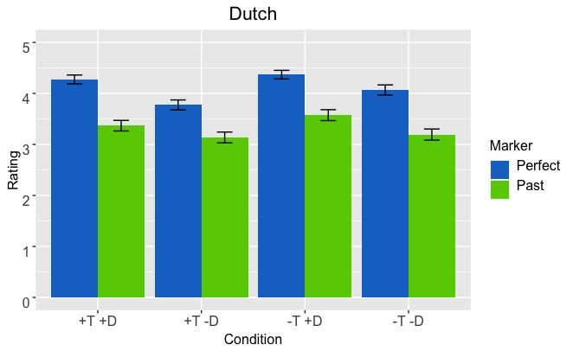
Dutch
Main effect of marker: perfect > past in all conditions (χ²(2) = 32.117; p < .001).
Notes:
When we look at the data per language, we see first that Dutch only presents a main effect of marker, favoring the perfect over the past across all conditions. We see in blue how the Perfect marker, the vtt., is significantly rated higher than the Past marker, the ovt, in all cases.

Slide 71
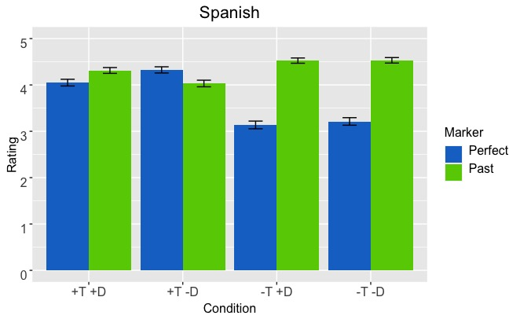
Spanish
Significant T*Marker interaction: past is better than perfect only in –T (χ²(1) = 57.07; p < .001), but they are not different in +T (χ²(1) = 0.016; p = .90). No effect of deixis.
Notes:
Spanish, on the other hand, presents a significant interaction of temporal distance and marker, with no effect of deixis. So while on –T adverbials, in the two pairs of columns of the right, there is an effect of grammatical marker, favoring the PAST over the Perfect, in the +T condition, when the adverbs are related to the day of utterance, there is no significant effect or marker, and both markers are rated relatively high. This is also a new finding, since it is not only the case that the Perfect is allowed to express hodiernal eventualities, but the Past competes with it, and is rated at the same level.

Slide 72
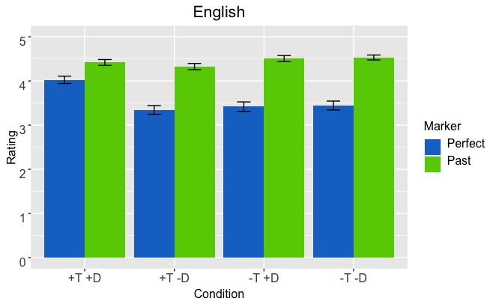
English
Significant T*D*Marker interaction: past is better than perfect in all conditions, but there is a less categorical difference in +T, +D. The difference is still significant in a posthoc test (β= 0.394; p = .035).
Notes:
Finally, in English, there is a three-way interaction between marker, temporal distance and deixis. In all cases there is a significant effect of marker too, favoring the Simple Past over the Present Perfect. However, that difference seems to be less categorical in the first pair of columns from the left, with adverbs that are both hodiernal and deictic.

Slide 73
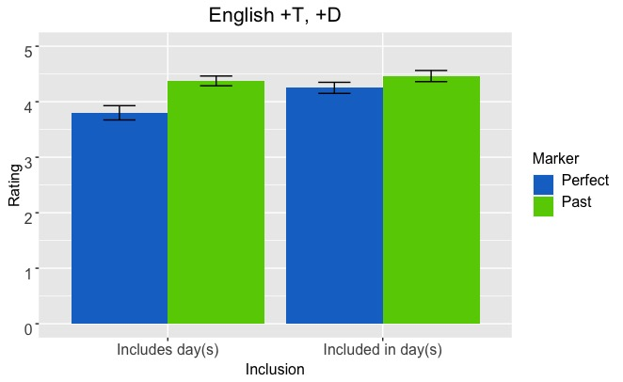
English: within +T +D
if we subdivide +T,+D adverbials when the adverb includes the day (S) (e.g., this month) the difference across markers is still significant (χ²(1) = 6.7711; p <.01), but when it is included in the day (S) (e.g., this morning), the difference across markers disappears (χ²(1) = 0.5942; p = .4408).
Notes:
Interestingly, if we subdivide those adverbials by considering whether the adverb includes the day of utterance (such as ‘this month’) or is included in it (such as ‘this morning’), we find that in the first case the difference across markers is still significant, so that the Past is rated significantly higher than the Perfect, but that difference disappears when it comes to the second type of adverbials, as can be seen in the pair of columns on the right.

Slide 74
Summary
Dutch: Perfect is allowed to refer to past events unconstrainedly. Past, in turn, is dispreferred for this purpose.
Spanish: Perfect is accepted when the event is clearly linked to the day of utterance, but there is no preference for this marker (contra Schwenter 1994 et seq), since the Past can also be used.
English: Past is preferred across conditions over the Perfect but this marker is more accepted with deictic hodiernal adverbials, especially when the adverb is included in the day (S) (e.g., this morning).
Notes:
So, to sum up, we have seen that in Dutch, the Perfect is allowed to refer to past events with no constraints, but the Past, in turn, is dispreferred. That in Spanish the Perfect is accepted when the event is clearly linked to the day of utterance, but there is no preference for this marker (contra Schwenter 1994 et seq), since the Past can also be used.
And that in English the Past is preferred across all conditions over the Perfect but the Present Perfect is more accepted with deictic hodiernal adverbials, especially when the adverb is included in the day of utterance, such as this morning).

Slide 75
Conclusion
Both hodiernality and deixis (and considerations about ‘proper’ hodiernality vs. ‘extended’ hodiernality) will have to be included in a crosslinguistic semantic analysis of the Perfect…
We are working on it!
Notes:
So we can conclude that both hodiernality and deixis, and considerations about proper hodiernality vs. extended hodiernality, as English shows, will have to be included in a crosslinguistically valid analysis of the Perfect…
And we are working on it!

Slide 76
general conclusions
Notes:
As for more general conclusions,

Slide 77
Take-home message
Translation Mining is a new, data-driven methodology that is able to pick up nuanced constraints at play in crosslinguistic variation.
Experimental work is also necessary to check the reliability of parallel-corpora generalizations, but also to refine them.
The constraints at play in selecting each Perfect/Past form are diverse across different languages.
Addressing crosslinguistic variation from a variety of data sources is crucial for advancing semantic generalizations about tense-aspect categories.
Time in Translation project: http://time-in-translation.hum.uu.nl/
Notes:
the take home message from today’s talk is that Translation Mining is a new, data-driven methodology that is able to pick up nuanced constraints at play in crosslinguistic variation on different semantic domains.
Experimental work is also necessary to check the reliability of the the generalizations obtained by this method, but also to refine them.
We have seen that the constraints at play in selecting each Perfect/Past form are diverse across different languages, proving that addressing crosslinguistic variation from a variety of data sources is crucial for advancing empirically valid semantic generalizations about tense aspect phenomena.
You can see more about our project in our website.

Slide 78
Selected references
Condoravdi, C. y Deo, A. 2015. Aspect Shifts in Indo-Aryan and Trajectories of Semantic Change. En C. Gianollo, A. Jäger y D. Penka (Eds.), Language Change at the Syntax-Semantics Interface (pp. 261-292). Nueva York: De Gruyter Mouton.
Iatridou, S., Anagnostopoulou. E., y Izvorski, R. 2003. Observations about the Form and Meaning of the Perfect. En A. Alexiadou, M. Rathert y A. von Stechow (Eds.), Perfect Explorations (pp. 153-202). Nueva York: De Gruyter Mouton.
Klein, W. 1992. The Present Perfect puzzle, Language 68, 525-552.
Le Bruyn, B.; M. van der Klis & H. de Swart. 2019. The Perfect in dialogue. Linguistics in the Netherlands 36(1), 162-175.
Löbner, S. 2002. Is the German Perfekt a Perfect Perfect? In I. Kaufmann & B. Stiebels (eds.), More than Words: A Festschrift for Dieter Wunderlich, 369–391. Berlin: Akademie Verlag.
Michaelis, L. 1994. The ambiguity of the English Present Perfect, J. of Linguistics 30, 111-157.
Portner, P. 2003. The (temporal) semantics and (modal) pragmatics of the perfect. Linguistics and Philosophy, 26, 459–510.
Schaden, G. 2009. Present Perfects compete. Linguistics and Philosophy 32(2), 115-141.
Schwenter, S. 1994. The grammaticalization of an anterior in progress: evidence from a peninsular Spanish dialect. Studies in Language 18: 71–111.
de Swart, H. 2007. A cross-linguistic discourse analysis of the perfect. Journal of Pragmatics 39, 2273-2307.
Notes:
These are some of the references from the presentation.

Slide 79
Merci de votre attention!
Danke für Ihre Aufmerksamkeit!
Bedankt voor jullie aandacht!
Gracias por su atención!
Thank you for your attention!
Research funded by NWO under grant 360-80-070.
Notes:
Thank you.

Slide 80
Summary
Type of adverbial | Marker | English | Spanish | Dutch
+T, +D (this morning) | perfect | 4.03 | 4.05 | 4.28
 | past | 4.42 | 4.31 | 3.37
+T, -D (at midnight) | perfect | 3.34 | 4.33 | 3.78
 | past | 4.33 | 4.03 | 3.14
-T, +D (last month) | perfect | 3.42 | 3.14 | 4.37
 | past | 4.51 | 4.53 | 3.58
-T, -D (in November) | perfect | 3.44 | 3.21 | 4.07
 | past | 4.53 | 4.53 | 3.19
Notes:
And these are the results across languages.

